Slide 1

Microservices Retrospective - What we learned (and didn't learn) from Netflix
Adrian Cockcroft | Qcon London | March 2023
@adrianco@mastodon.social
All photos taken by Adrian, mostly in Maui
Notes:
A retrospective on microservices, what we set out to do at Netflix, how it worked out, and how things have subsequently permeated across the industry, along with some of the [mis]appropriations etc. that have since happened. The first talks I gave at QCon SF in 2011 and QCon London in 2012 were on the Netflix cloud architecture. We subsequently agreed to call it microservices and started open sourcing components of the architecture, and the term really took off in 2013 along with the launch of Docker and containers. Looking back at the original ideas and motivations, most of the core concepts were adopted, but some key ideas went missing along the way. This has led to some of the complaints we hear today about things that are hard to do with microservices in practice, that we anticipated and solved for at the time.

Slide 2

Retrospective? Time for me to learn some Agile rituals…

Slide 3
Netflix was extremely agile, without the rituals of Extreme or Agile

Slide 4
Story Points? Retrospectives and Netflix Culture Netflix in the Cloud – QconSF 2010, Cassandra Summit 2011 Cloud Native Applications 2013 Microservices – Dockercon and MicroXchg Berlin 2016 Why don’t microservices work for some people?

Slide 5

Values are what we value
High performance
Freedom and responsibility
Context, not control
Highly aligned, loosely coupled
Pay top of market
Promotions and development
Culture
Seven aspects of Netflix culture

Slide 6
Optimized for agility, minimized processes
Ability to evolve rapidly
Pioneers, happy to be first to do something
Comfortable with ambiguity
Creativity and self discipline combined
Flexibility is more important than efficiency
Steer any pain to where it can be helpful
Systems Thinking

Slide 7
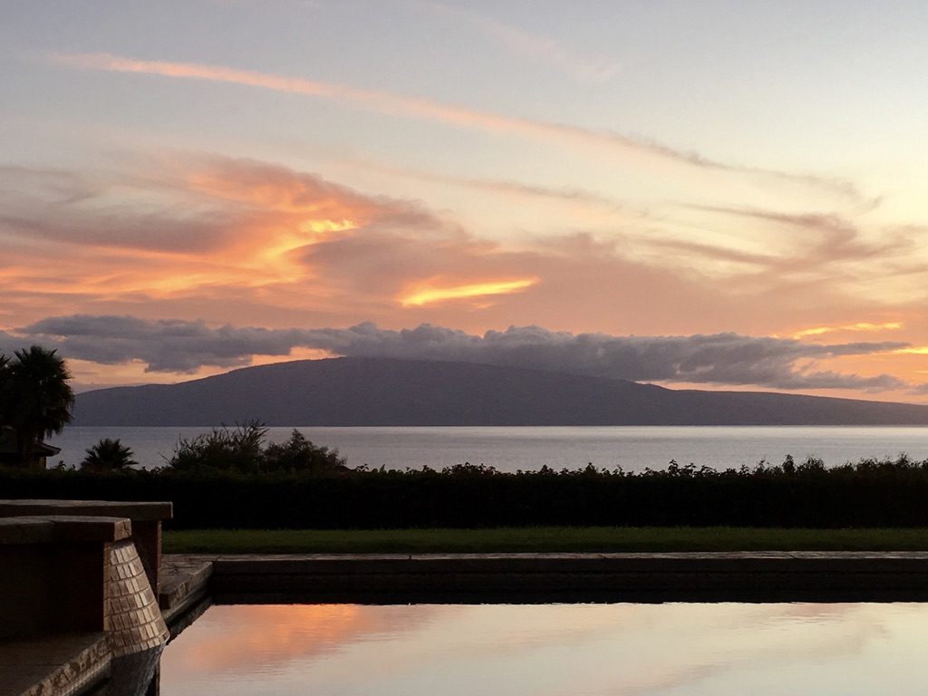

Slide 23
This lesson wasn’t learned – the wire protocol shouldn’t be the interface between microservices

Slide 24
Analogy – Disk, SCSI driver, Filesystem

Slide 31
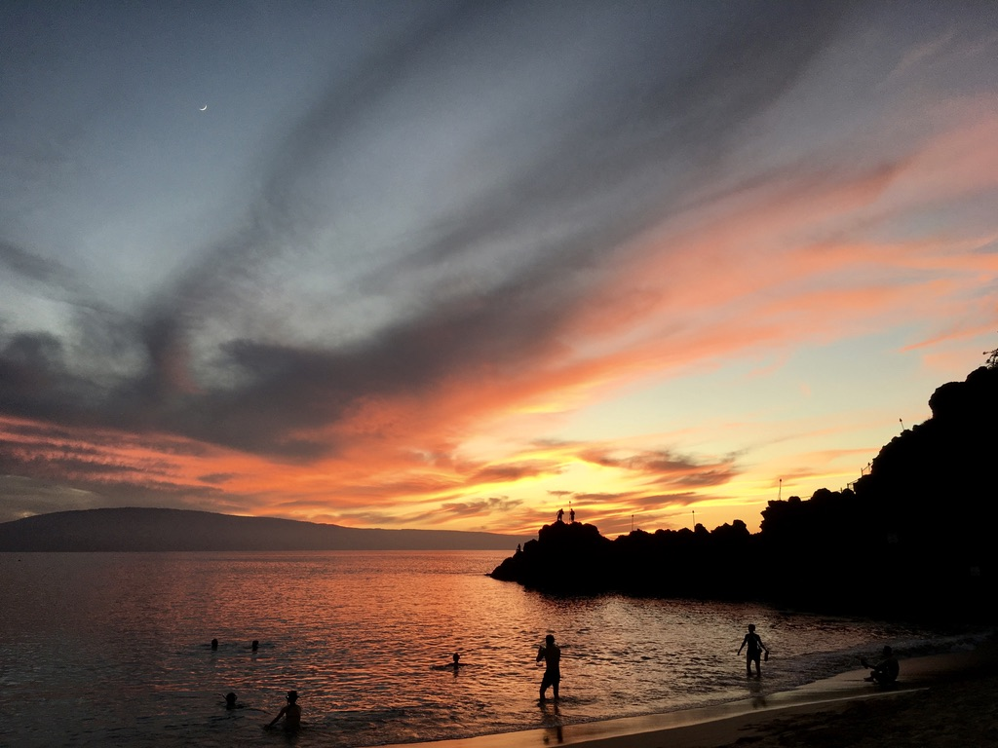
Response to 2010 talk was a mixture of incomprehension and confusion. Most people thought we were crazy and would be back in our datacenters when it failed…

Slide 32
Less than a year later…

Slide 39
Actually 10-100km apart

Slide 42
Architecture design control
Be sure you can auto-scale down!

Slide 44

Response to 2011 progress was that Netflix was a Unicorn, and while it might work for us, it wasn’t relevant to others

Slide 45
18 Months later in 2013 Early use of Cloud Native and Microservices terminology

Slide 46

Cloud Native Applications: What Changed?
February 2013
Adrian Cockcroft
@adrianco #netflixcloud @NetflixOSS
http://www.linkedin.com/in/adriancockcroft

Slide 47
Cloud Native?
Agile Infrastructure
NetflixOSS – Cloud Native On-Ramp

Slide 48
February 8th, 2005

Slide 49
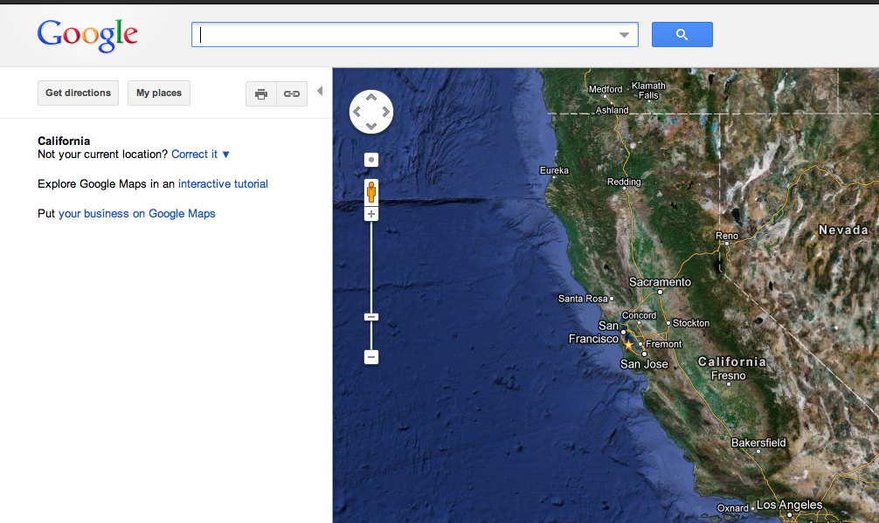
Google Maps Launched

Slide 50
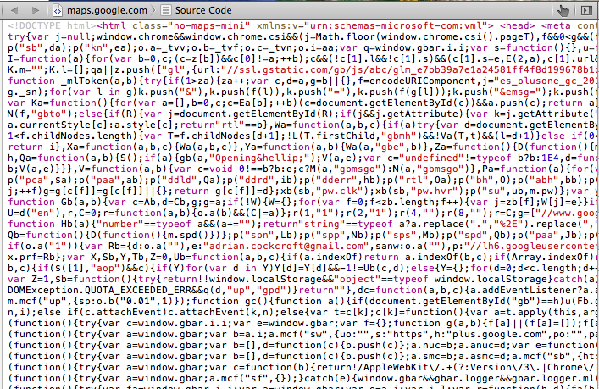
View Source

Slide 51
Web 2.0 Had Arrived…
Static HTML -> JavaScript

Slide 52
Web Native Applications
Running in the browser

Slide 53
Code Visible to Everyone
Techniques spread rapidly

Slide 54
Totally new development patterns and tools
(Slow enterprise adoption)

Slide 55
August 25th, 2006

Slide 56
AWS EC2 Launched
Infrastructure as a Service

Slide 57
Forklift Old Code to the Cloud
Faster than datacenter deployments but fragile

Slide 58
New Anti-Fragile Patterns
Micro-services
Chaos engines
HA systems composed from ephemeral components

Slide 59
Open Source Platforms
Techniques spread rapidly

Slide 60
Totally new development patterns and tools
(Slow enterprise adoption)

Slide 61
Hybrid Cloud Architecture
iOS/Android
App Server
MySQL
Cloud
Datacenter
Mobile
Legacy Apps

Slide 62
Cloud Native Architecture
Things
JVM
Cassandra
Cassandra
Autoscaled Micro Services
Distributed NoSQL Datastores
Clients
Cassandra
JVM
JVM
JVM
Autoscaled Micro Services
JVM
Memcached

Slide 63
Cloud Native
Master copies of data are cloud resident
Everything is dynamically provisioned
All services are ephemeral
Cloud native meant that the application code was optimized to only run in the cloud
The CNCF later co-opted the term to mean code for running clouds…

Slide 64
Scale
Public vs. Private Clouds
Rate of change matters
How big is too big?

Slide 65
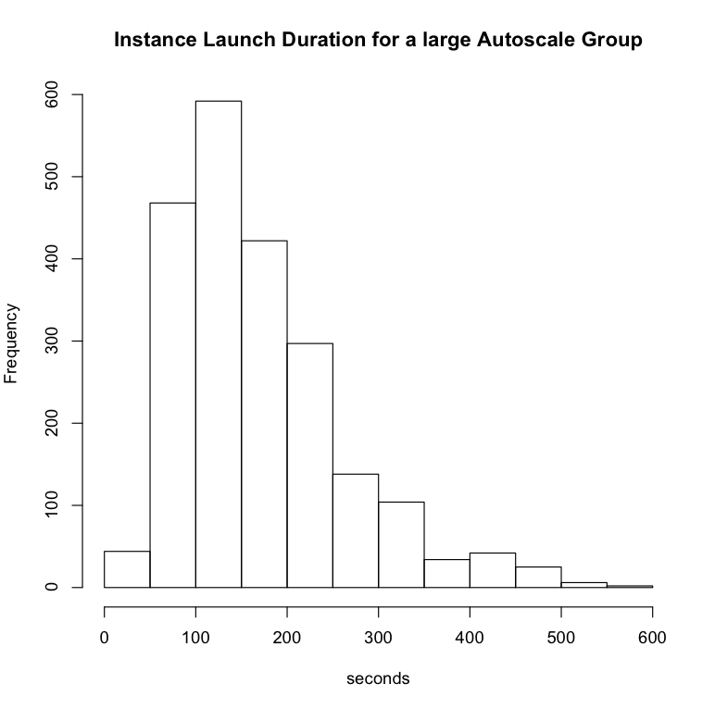
Cloud Deployment Scalability
New Autoscaled AMI – zero to 500 instances from 21:38:52 - 21:46:32, 7m40s
Scaled up and down over a few days, total 2176 instance launches, m2.2xlarge (4 core 34GB)
Min. 1st Qu. Median Mean 3rd Qu. Max.
41.0 104.2 149.0 171.8 215.8 562.0

Slide 66
Leveraging Public Scale
Public
Grey Area
Private
1,000 Instances
100,000 Instances
Startups
Netflix
Google

Slide 67
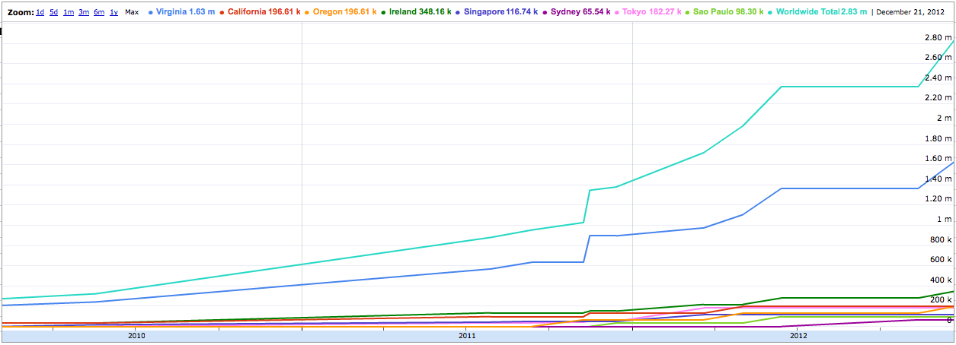
Size and Growth Rate
AWS Maximum Instance Count Growth
~9x in Three Years, ~300% Per Annum
AWS upper bound estimate based on the number of public IP Addresses

Slide 68
Availability
Is it running yet?
How many places is it running in?
How far apart are those places?

Slide 69
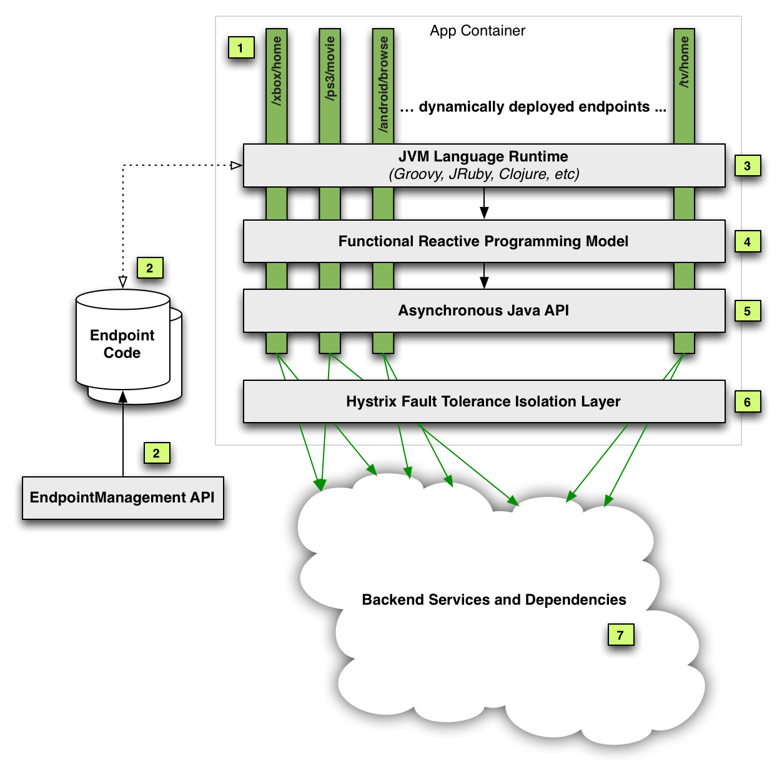
Antifragile Development Patterns Functional Reactive with Circuit Breakers and Bulkheads
Hystrix circuit breaker
library was an influential and successful Netflix open source project

Slide 70
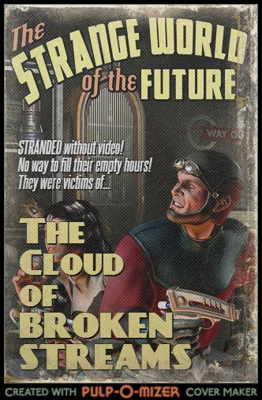

Slide 71
Managing Multi-Region Availability
AWS Route53
DynECT DNS
UltraDNS
Zone A
Cassandra Replicas
Zone B
Cassandra Replicas
Zone C
Cassandra Replicas
Regional Load Balancers
Regional Load Balancers
Zone A
Cassandra Replicas
Zone B
Cassandra Replicas
Zone C
Cassandra Replicas
What we need is a portable way to manage multiple DNS providers….

Slide 72
Denominator Software Defined DNS
Denominator
AWS Route53
DynECT
Common Model
DNS Vendor Plug-in
UltraDNS
Etc…
Edda, Multi-Region Failover
Use Cases
API Models (varied and mostly broken)
IAM Key Auth REST
User/pwd REST
User/pwd SOAP
Currently being built by Adrian Cole (the jClouds guy, he works for Netflix now…)

Slide 73
Capacity
Interesting apps are unpredictable
Just in time provisioning
Give it back

Slide 74
Capacity Profiles

Slide 75
Cloud Costs
Unpredictable?
Post-optimized reservations
Capitalize the base load

Slide 76
Configuration Management
Datacenter CMDB’s woeful
Cloud is a model driven architecture
Dependably complete

Slide 77
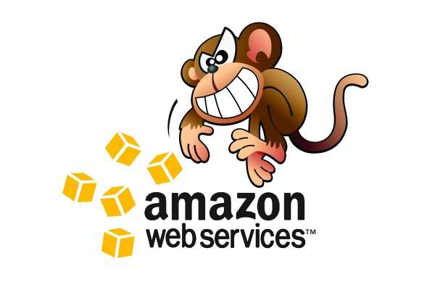
Edda – Configuration History http://techblog.netflix.com/2012/11/edda-learn-stories-of-your-cloud.html
Edda
AWS Instances, ASGs, etc.
Eureka Services metadata
AppDynamics Request flow
Monkeys

Slide 78
Edda Query Examples
Find any instances that have ever had a specific public IP address
$ curl "http://edda/api/v2/view/instances;publicIpAddress=1.2.3.4;_since=0"
["i-0123456789","i-012345678a","i-012345678b”]
Show the most recent change to a security group
$ curl "http://edda/api/v2/aws/securityGroups/sg-0123456789;_diff;_all;_limit=2"
--- /api/v2/aws.securityGroups/sg-0123456789;_pp;_at=1351040779810
+++ /api/v2/aws.securityGroups/sg-0123456789;_pp;_at=1351044093504
@@ -1,33 +1,33 @@
{
…
"ipRanges" : [
"10.10.1.1/32",
"10.10.1.2/32",
+ "10.10.1.3/32",
- "10.10.1.4/32"
…
}
Not sure if this lesson was learned… but the ability to query the entire history of your infrastructure is very powerful

Slide 79
Security
Security baked into patterns
Strong assertions
Iterate over infrastructure

Slide 80
Impossible Things
Reducing friction
Speeding up the OODA cycle
Rapid innovation

Slide 81
Product Lifecycle
Idea
Concept
Development
Experimentation
Operation
Scaling
Retirement
Shut down
Testing
Optimization
Hypothesis
Archive
OODA Loop for Testable Ideas
Cloud - Each step takes minutes
Datacenter – Weeks or months

Slide 82
Real Example – Proxy in Brazil
AWS Brazil makes this trivial
Test didn’t show a big benefit
Shut it down and try something else
Idea
Front end in BR
Development
Reconfigure proxy
Operation
Deploy in 2 zones
Retirement
Shut down
Test traffic in BR
Scale to traffic
Latency reduction
Archive data
OODA Loop for Testable Ideas
Cloud - Each step takes minutes
Datacenter – Weeks or months

Slide 83
Scalability from 48 to 288 nodes on AWS http://techblog.netflix.com/2011/11/benchmarking-cassandra-scalability-on.html
Frictionless infrastructure experiments!
Used 288 of m1.xlarge
4 CPU, 15 GB RAM, 8 ECU
Cassandra 0.86
Benchmark config only existed for about 1hr
This benchmark was used by Datastax in a “Million Writes Per Second” ad campaign

Slide 84

A Cloud Native Open Source Platform
Open source has become a common way to build
a technology brand and influence the industry

Slide 85
Three Questions
Why is Netflix doing this?
How does it all fit together?
What is coming next?

Slide 86
Platform Evolution
Bleeding Edge Innovation
Common Pattern
Shared Pattern
2009-2010
2011-2012
2013-2014
Netflix ended up several years ahead of the industry, but it’s not a sustainable position
Notes:
When Netflix first moved to cloud it was bleeding edge innovation, we figured stuff out and made stuff up from first principles. Over the last two years more large companies have moved to cloud, and the principles, practices and patterns have become better understood and adopted. At this point there is intense interest in how Netflix runs in the cloud, and several forward looking organizations adopting our architectures and starting to use some of the code we have shared. Over the coming years, we want to make it easier for people to share the patterns we use.

Slide 87

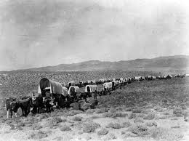
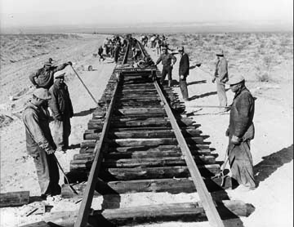
Making it easy to follow
Exploring the wild west each time
vs. laying down a shared route
Notes:
The railroad made it possible for California to be developed quickly, by creating an easy to follow path we can create a much bigger ecosystem around the Netflix platform

Slide 88
Goals
Build up Netflix Technology Brand
Hire, Retain and Engage Top Engineers
Establish our solutions as Best Practices / Standards
Benefit from a shared ecosystem

Slide 89
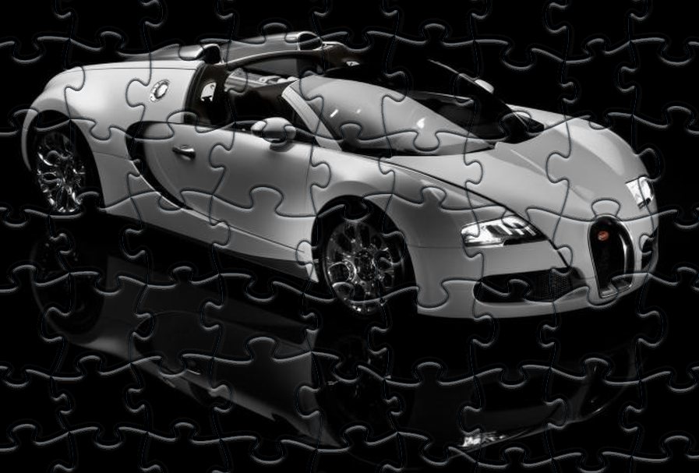
How does it all fit together?

Slide 90
NetflixOSS Continuous Build and Deployment
Github
NetflixOSS
Source
Maven
Central
AWS
Base AMI
Jenkins
Bakery
Dynaslave
AWS Build Slaves
AWS
Baked AMIs
Odin
Orchestration
API
Asgard
(+ Frigga)
Console
AWS Account

Slide 91
NetflixOSS Services Scope
AWS Account
Asgard Console
Multiple AWS Regions
Eureka Registry
Exhibitor ZK
3 AWS Zones
Evcache
Memcached
Ephemeral Storage
Cross region Priam C*
Edda History
Simian Army
Archaius Config Service
Explorers Dashboards
Atlas
Monitoring
Application Clusters
Autoscale Groups
Instances
Priam
Cassandra
Persistent Storage
Genie Hadoop Services

Slide 92
NetflixOSS Instance Libraries
Service Requests
Hystrix/Turbine – dependencies and real-time status
Ribbon - REST Client for outbound calls
Logging
Blitz4j – non-blocking logging
Initialization
Governator – Guice based dependency injection
Archaius – dynamic configuration properties client
Servo – metrics export for autoscaling
Karyon - Base Server for inbound requests
RxJava – Reactive pattern
Atlas – high volume instrumentation
Baked AMI – Tomcat, Apache, your code
Eureka - service registration client
Data Access
Astyanax – Cassandra client and pattern library
Evcache – Zone aware Memcached client
Curator – Zookeeper patterns
Denominator – DNS routing abstraction

Slide 93
NetflixOSS Testing and Automation
Test Tools
CassJmeter – load testing for C*
Availability
Chaos Monkey - Instances
Security
Security Monkey
Conformity Monkey
Latency Monkey – latency and error injection
Maintenance
Janitor Monkey
Efficiency Monkey
Chaos Gorilla – Availability Zones
Doctor Monkey
Circus Monkey – test rebalancing
Howler Monkey
Chaos Kong - Regions

Slide 94
More Features
What’s Coming Next?
Better portability
Higher availability
Easier to deploy
Contributions from end users
Contributions from vendors
NetflixOSS was much too hard to deploy for too long. Lack of investment in key internal components that weren’t ready to be shared in time
We learned from the problems and launch of Spinnaker a few years later was much better
More Use Cases

Slide 95
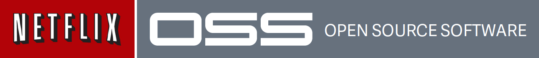
Functionality and scale now, portability coming
Moving from parts to a platform in 2013
Netflix is fostering an ecosystem
Rapid Evolution - Low MTBIAMSH
(Mean Time Between Idea And Making Stuff Happen)

Slide 96
Takeaway for Net Futures
Adopt Cloud Native patterns and take the friction out of innovation.
(and please don’t build broken APIs…)
http://netflix.github.com
http://techblog.netflix.com
http://slideshare.net/Netflix
http://www.linkedin.com/in/adriancockcroft
@adrianco #netflixcloud @NetflixOSS

Slide 97
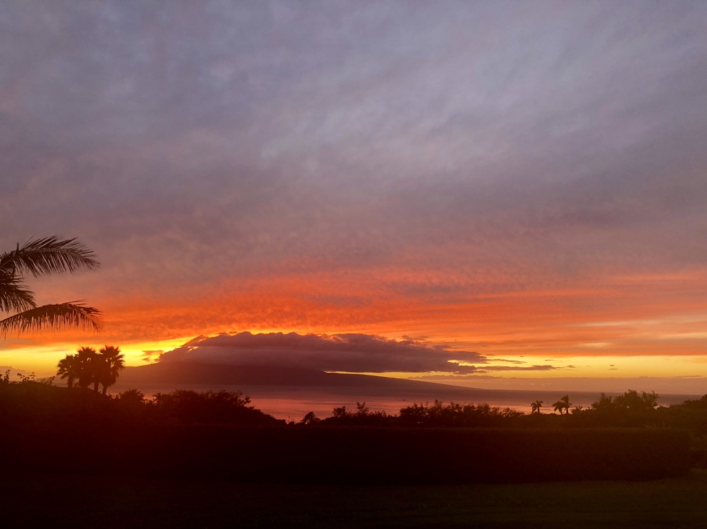
Adrian left Netflix in January 2014 and joined Battery Ventures just as Docker containers began to take off as a microservices pattern…

Slide 98
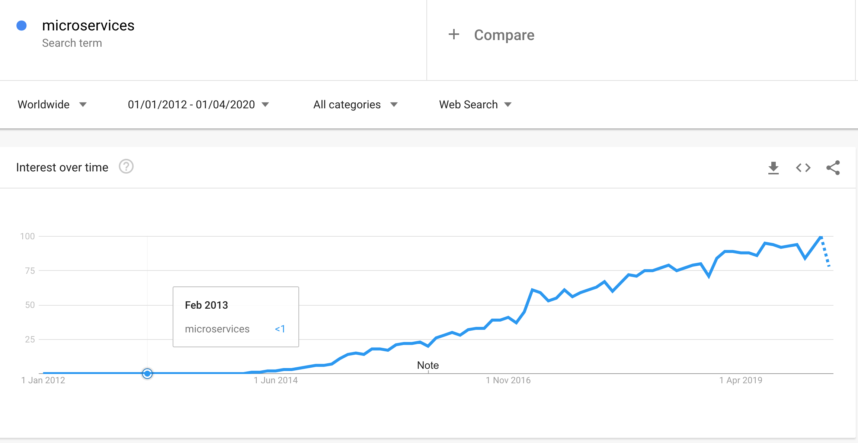
Trends: Microservices
MicroXchg Berlin event where a group of speakers including @adrianco adopted the term

Slide 108
Netflix was accused of “Ruining the cloud” because we didn’t use Chef/Puppet to update our code, we just started a new instance
The Netflix model used version-aware routing between services, another idea that seemed to get lost along the way…

Slide 125
These lessons weren’t learned, most microservices frameworks still suffer from retry storms as far as I can tell

Slide 127
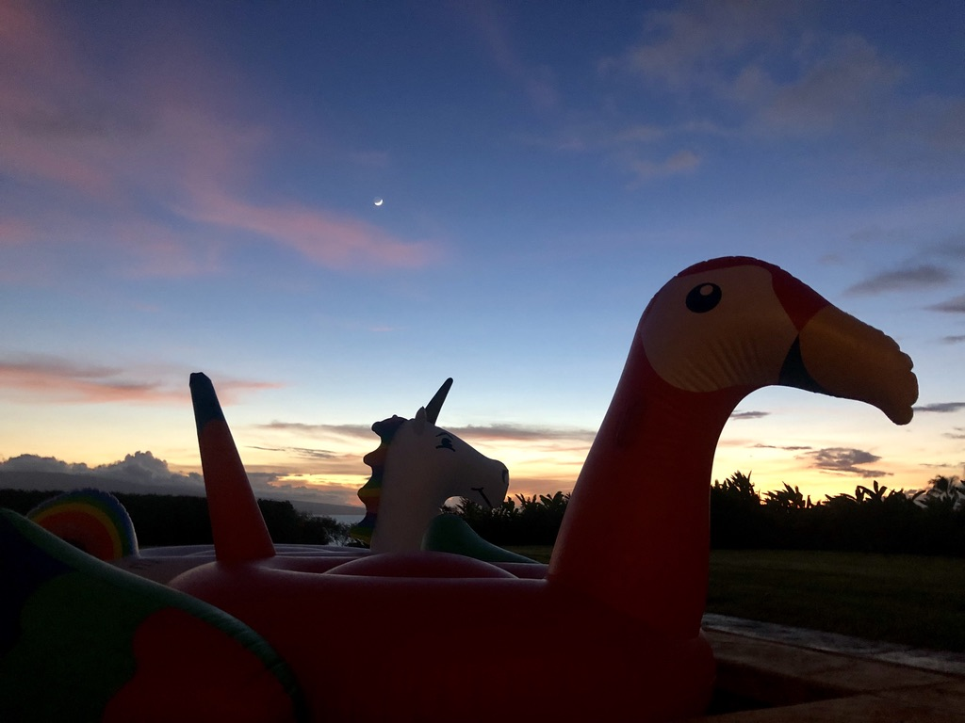
We tried microservices and it didn’t work!

Slide 128
Are you a unicorn or a donkey with a carrot tied to it’s forehead?

Slide 129
Microservices is one of many tactics that reinforce each other to form a system that is fast, resilient, scalable and efficient

Slide 130
Too slow? Stop using chatty/inefficient protocols Pick your system boundaries better

Slide 131
Not resilient? Fix retry storms Put developers on call Use chaos engineering to leverage AZs properly

Slide 132
Not scalable? Denormalize your data models Tune code for vertical scaling

Slide 133
Not efficient? Autoscale deeply Target 40-50% average utilization Turn things off, use serverless

Slide 134
If you left out most of the system, then it’s not surprising that it’s not working for you…

Slide 135

Backlog

Slide 137
Netflix is running an Olympic sports team, not a family

Slide 138
“We can’t copy Netflix because it has all those superstar engineers, we don’t have the people”
Fortune 100 CTO after a Netflix presentation - 2013
“We hired them from you, and got out of their way…”
Adrian Cockcroft - in response

Slide 139
See also W. Ross Ashby’s Law of Requisite Variety
Simplification and efficiency drives can go too far

Slide 141
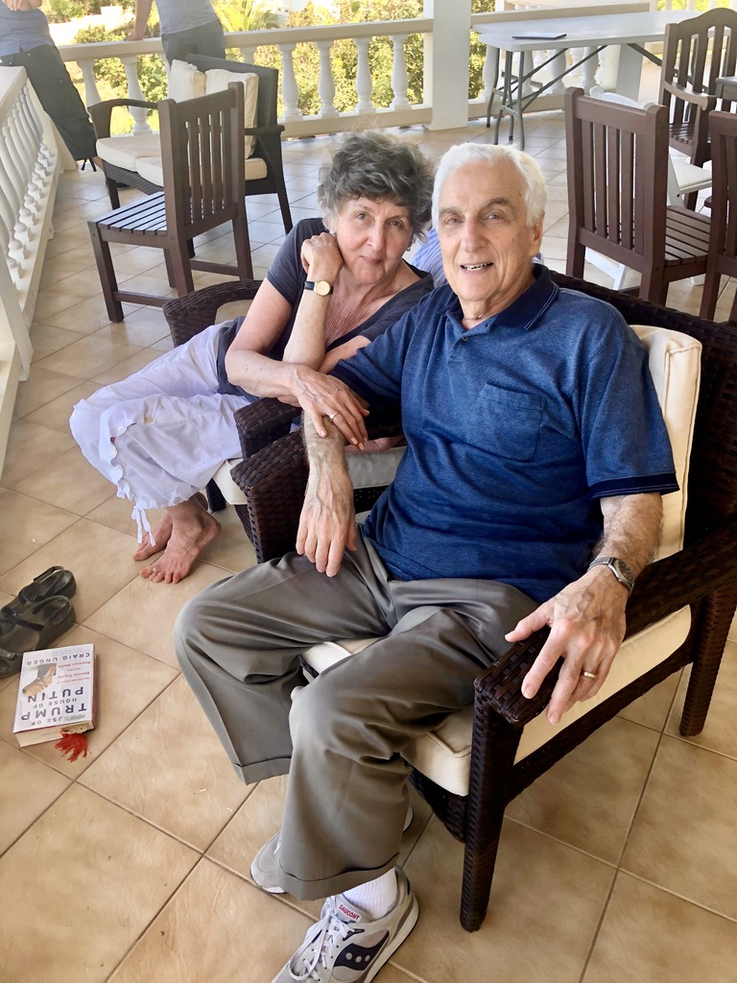
Ruth and Mel Conway 2019

Slide 142
Run what you wrote – Werner Vogels
This is one of the lessons that didn’t get learned widely enough

Slide 143
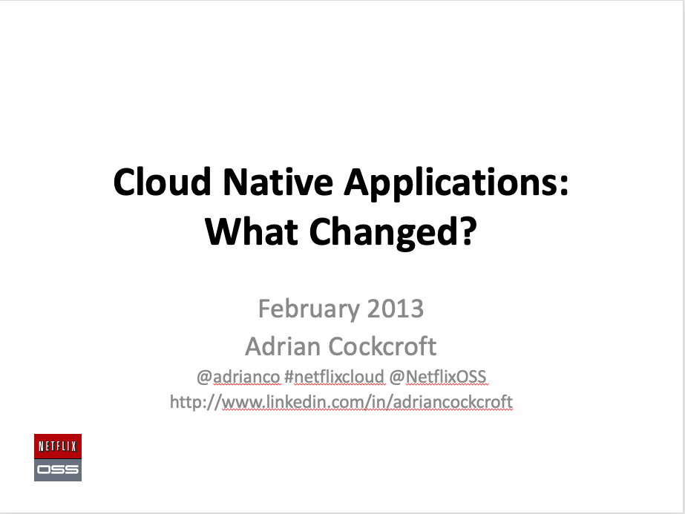
This talk features excerpts from these decks
https://www.slideshare.net/adrianco - Netflix era decks
https://www.slideshare.net/adriancockcroft - Battery Ventures decks
https://github.com/adrianco/slides - AWS decks and later including a pdf of these slides!
https://www.youtube.com/@adriancockcroft

Slide 144

Antipattern: You didn’t protect unprepared organizations from the dangers of introducing advanced technology, knowledge and values, before they are ready…

Slide 145

Microservices Retrospective - What we learned (and didn't learn) from Netflix
Adrian Cockcroft | Qcon London | March 2023
@adrianco@mastodon.social
Notes:
A retrospective on microservices, what we set out to do at Netflix, how it worked out, and how things have subsequently permeated across the industry, along with some of the [mis]appropriations etc. that have since happened. The first talks I gave at QCon SF in 2011 and QCon London in 2012 were on the Netflix cloud architecture. We subsequently agreed to call it microservices and started open sourcing components of the architecture, and the term really took off in 2013 along with the launch of Docker and containers. Looking back at the original ideas and motivations, most of the core concepts were adopted, but some key ideas went missing along the way. This has led to some of the complaints we hear today about things that are hard to do with microservices in practice, that we anticipated and solved for at the time.

